Slide 1
The great organ deficit a 21st century problem: What you can do to help
06 July 2016
Professor Magi Sque
The University of Opportunity

Slide 2
Foci of presentation
The scale of the organ deficit for human transplantation.
The reasons why the deficit exists.
What helps us to understand the reasons why the deficit exists.
What can be done to reduce the deficit.
Provide insight into the lasting legacy of donation.
The University of Opportunity

Slide 3
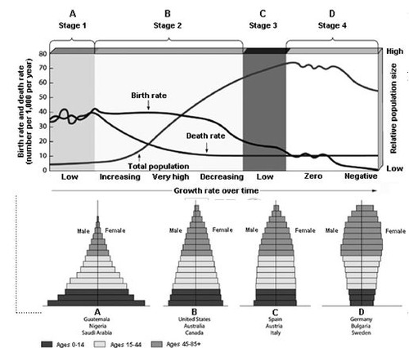

Slide 4
Deceased donors, transplants and the transplant waiting list 2003-2016
Notes:
4
4
Indeed we have almost increased the number of deceased donor transplants by 50% - 3514 compared to 2381 in 2007-8.
More transplants last year than ever before
Falling numbers on the transplant waiting list

Slide 5
European deceased donation rates, 2013
Notes:
5
We have already seen some comparative international data so I will not dwell on them too long, save to say that raw deceased donor data does not tell the whole story.
Indeed one of the biggest questions facing us is not only why there is variation overall in the number of deceased donors, but also why there is so much variation

Slide 6
DBD pathway
100
90
17%
2%
4%
80
7%
s
70
r
o
n
o
60
d
l
Potential DBD donor: a patient who has been certified dead by brainstem criteria
Conversion rate 45%
33%
a
i
t
50
9%
n
e
t
o
p
40
f
o
%
30
20
10
0
Potential
Neurological
Neurological
Contraindications
Family
Consent/
Donation
donors
1
death tests
death
approach
authorisation
performed
confirmed
Notes:
When you compare this to DBD, we can say that for every 100 brain dead patients we get 45 donors, but for every 100 patients who die after treatment withdrawal, we get just 8 donors.
Put another way, for every family of a potential DBD donor approached, we get 2 organs, but we have to approach 2 DCD families to get one organ.
You must streamline the early stages.

Slide 7
Controlled DCD pathway
100
90
80
29%
s
70
r
o
n
o
60
d
l
Potential DCD donor: a patient who had treatment withdrawn and death anticipated within 4 hours
Conversion rate 8%
a
i
t
50
n
e
t
53%
o
p
40
f
o
%
30
48%
20
53%
10
0
Potential
Neurological
Neurological
Contraindications
Family
Consent/
Donation
donors
1
death tests
death
approach
authorisation
performed
confirmed
(DBD only)
(DBD only)
Notes:
But I warn you, DCD is resource intensive, as shown by this step chart of potential DCD donors
A third of potential DCD donors are lost because they have a medical contraindication to donation
The families of those who remain are not approached on 50% of occasions
Half of the families who are approached say no in the UK
And half of the consented DCD donors do not proceed because the time from WLST to asystole is too long

Slide 8
Temporal framework
Present
Future
Past
(Walker W. Broderick A. and Sque. M. 2013)
The University of Opportunity
Notes:
‘The Past’ represented families’ prior knowledge, experience, attitudes, beliefs and intentions that may have influenced the donation decision;
‘The Present’ incorporated influences concerning the moment in time when bereaved families experienced the potential for organ donation;
‘The Future’ corresponded to influences based on perceived expectations and outcomes arising from the donation decision.
This framework, we believe, provided a unique lens through which to capture the factors that appeared to provide the context for the impact of the donation request and the donation.
So what were these factors:

Slide 9
The Past
Motivation to fulfil the wishes of the deceased
Knowledge /beliefs about the deceased’s wishes
Affirming the deceased’s wishes
The will of the deceased
Predisposition of family members
Prior knowledge of, and/or experience with organ donation/
transplantation
Attitudes/beliefs about organ donation/transplantation
The University of Opportunity
Notes:
Looking at the past we identified two main categories that set the parameters for the reaction to the donation these were the will of the deceased and the predisposition of the family members. The will of the deceased was comprised of three themes ....
Predisposition of family members was supported by ....

Slide 10
The Present
Knowledge and understanding and
recognition of death
Protecting the body
Psychological distress
Intra/interpersonal determinants
Comprehending the situation
Information to support decision-making
Influences of family/friends
Care and provision
Patient and family care
The donation discussion
Nature of request/approach
Relationships with healthcare staff
Timing of the approach
Characteristics of the requestor
The University of Opportunity
Notes:
Integration of the present produced four categories: Intra/interpersonal determinants, comprehending the situation, patient and family care and issues concerning the donation discussion.

Slide 11
The Future
Transcendence
Hopes and expectations
Giving meaning to life/death
The University of Opportunity
Notes:
The future concerned three broad categories of transcendence, hopes and expectations and giving meaning to life.

Slide 12
WAITING
To see relative in ED/ICU
For information
For death
For donation to happen
The University of Opportunity
Notes:
Re: information - the need for regular updates from the SN-OD was an identified area for improvement.

Slide 13
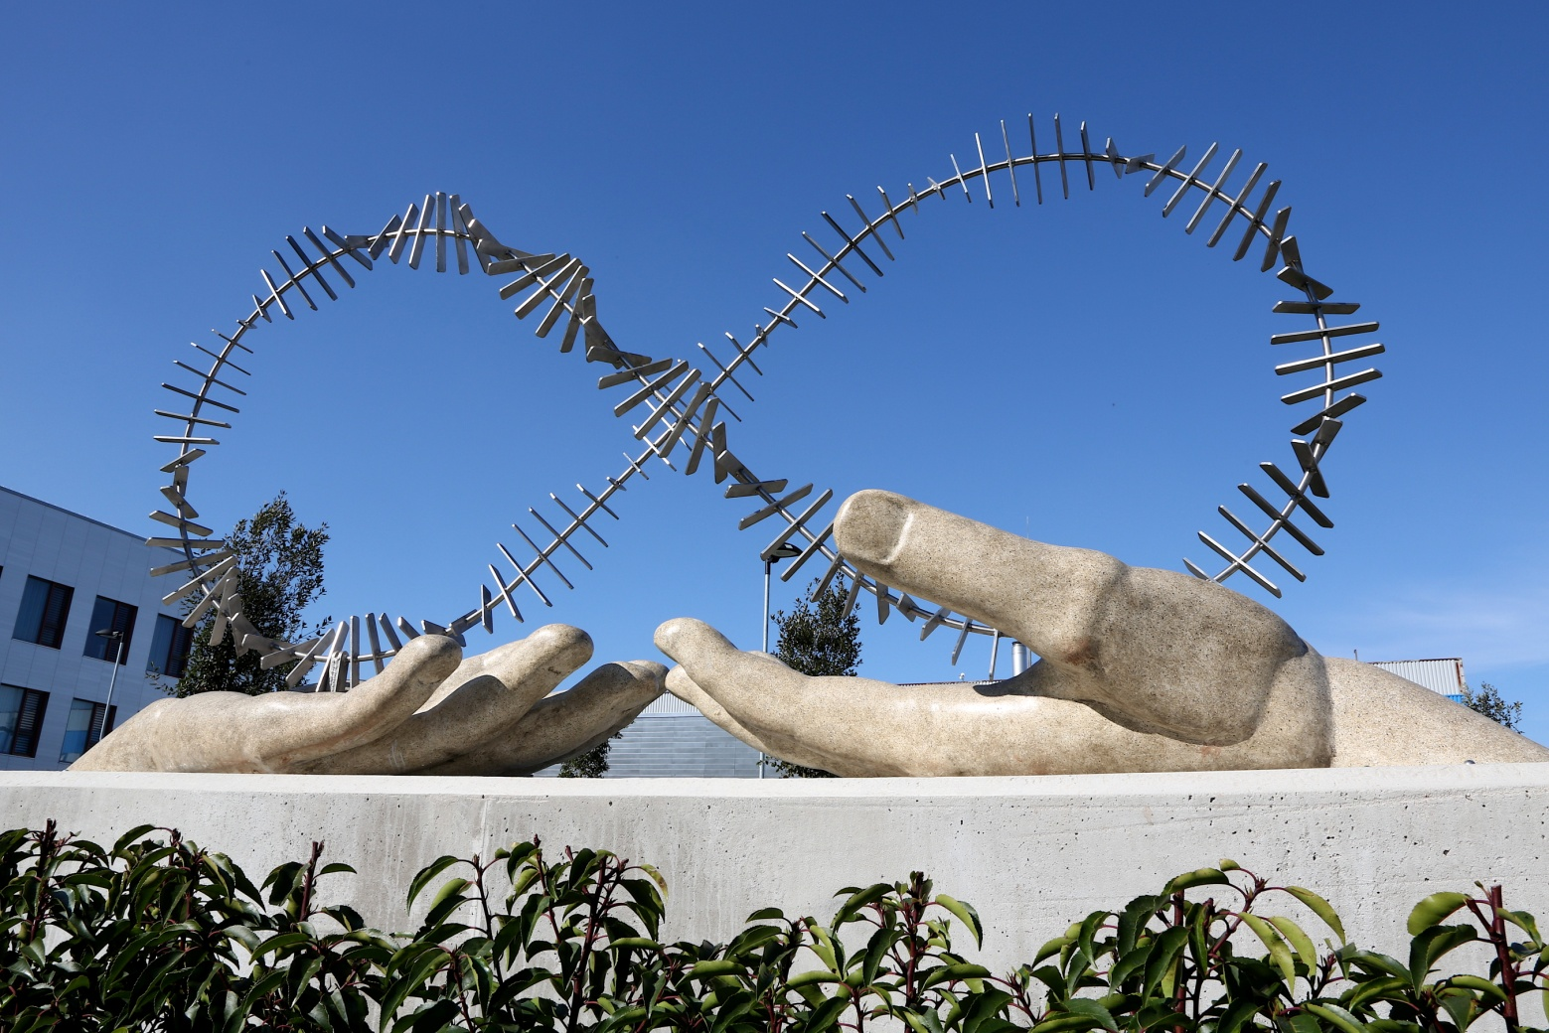
Organ donor memorial at New Cross Hospital, Wolverhampton

Slide 14
Acknowledgements
Thank you to our study participants
and research funders
The University of Opportunity

Slide 15
References
Sque M. Long T. and Payne S. and Allardyce D. Why relatives do not donate organs for transplants: 'sacrifice' or 'gift of life'? Journal of Advanced Nursing, 61: 2, 2008, 134-144.
(Paper of the month for Journal of Advanced Nursing January, 2008, editorial by Professor Alison Tierney 61:2, and had a press release).
Sque M. Walker W. Long-Sutehall. T. Morgan M. Randhawa G. and Warrens A. Bereaved families' experiences of organ and tissue donation, and perceived influences on their decision making. Final report of a study funded by the Department of Health, University of Wolverhampton, UK, 2013.
Walker W. Broderick A. and Sque M. Factors influencing bereaved families' decisions about organ donation: An integrative review of the literature. Western Journal of Nursing Research, 35: 10, 2013,1339-1359.
Walker W. Sque M. Carpenter B. and Roberts S. Recognising the gift of organ and tissue donation: The views and preferences of donor families. Final report of a study funded by The Royal Wolverhampton NHS Trust Organ Donation Committee. University of Wolverhampton, UK, 2014.
The University of Opportunity

